Slide 1
Netflix Content Strategy & Trend Analysis(2002_2021)
An End to End Data Analysis Using
Python: Pandas, Numpy, Matplotlib
SQL, Power Bi

Slide 2
Data preparation & Cleaning
Before jumping into the visuals, I had to roll up my sleeves and get the data ready. The raw "duration" column was messy—it had "min" for movies and "Seasons" for TV shows. To make it work, I cleaned the strings and converted them into pure numbers. I also filtered out the missing values so that our charts wouldn't be skewed by empty rows. This foundation is what makes the following insights reliable.

Slide 3
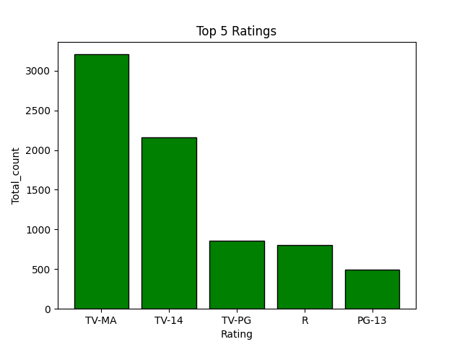
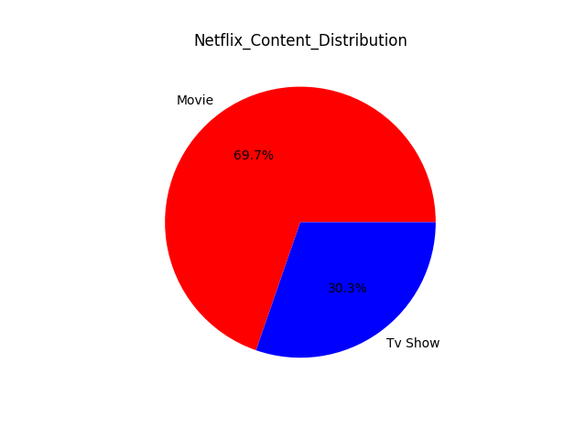
INSIGHTS
After analyzing the numbers, several major trends stood out:
The Movie Empire: Netflix is clearly a movie-first platform. With over 6,000 movies compared to roughly 2,600 TV shows, the library is heavily weighted toward cinematic content.
The Global Leaders: The content is dominated by the US, but India is a massive second player. It's interesting to see how local directors like Rajiv Chilaka are driving huge volumes of content specifically for the Indian market.
The 2019 Peak: There was a massive "content boom" in 2018 and 2019. However, looking at 2021, we see a sharp drop. This suggests that the global lockdowns significantly slowed down production schedules.
The Mature Audience Focus: A huge chunk of the library (TV-MA and TV-14) is designed for adults and teenagers. Netflix isn't just a "family" app; it’s a platform for mature storytelling.

Slide 4
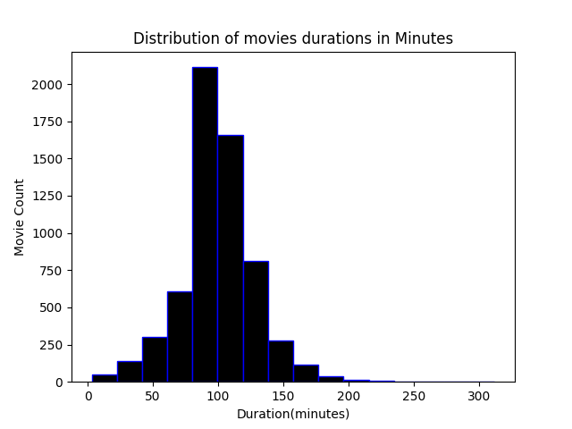
The 90 minute Sweet spot
One of the most fascinating findings came from looking at the distribution of movie lengths.
The Consistency: Most movies fall between 90 and 110 minutes. This isn't a coincidence; it’s the "sweet spot" for human attention spans in the digital age.
The Outliers: While most stay under 2 hours, we found "extreme" movies reaching up to 300 minutes. These are rare gems—likely deep-dive documentaries or historical epics that break the standard mold.

Slide 5
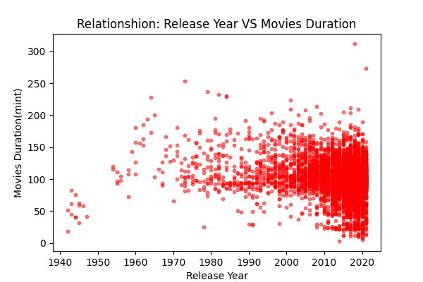
Evolution Over Time
Looking at the relationship between the release year and duration, we noticed that modern movies are actually becoming more "standardized." In the past, movie lengths were all over the place, but recently, Netflix has kept things very consistent.

Slide 6
Decisions
Double Down on the 95-Minute Format: Since this is where the highest volume sits, it’s clearly what the production pipeline is optimized for. Keep new originals in this range.
Bridge the 2021 Gap: Because production slowed down recently, Netflix should focus on acquiring high-quality "TV-MA" licensed content to keep the mature audience engaged while new originals are being filmed.
Localize the Power: Continue the partnership with regional powerhouses like India. The data shows that localized content from top directors is a major pillar of their international growth.

Slide 7
Conclution
In conclusion, this project wasn't just about making pretty charts; it was about understanding the heartbeat of the world's largest streaming service. By cleaning the data and visualizing the trends, we’ve proven that Netflix’s success is built on a very specific formula: High-volume, 95-minute, mature-rated movies aimed at global markets.

